Slide 1

Why you should learn Programming?
I chose this topic because I’m a programmer myself and I have learned programming alot, and I truly enjoy talking about it. Also decided to present this topic individually because I couldn’t find any other student who shared the same interest – so I decided to present it individually

Slide 2
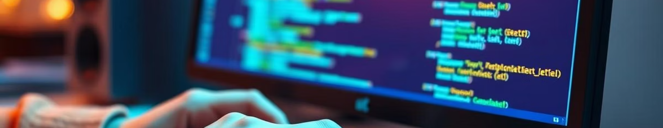
Reasons of choosing topic
My Journey in Code
A Core Skill for CS Students
I've programmed for two years, earning certifications and freelancing. This journey fuels my desire to share programming's power with you.
Programming is crucial in our digital world. Since you're studying computer science, it's the perfect time to deepen your understanding.

Slide 3
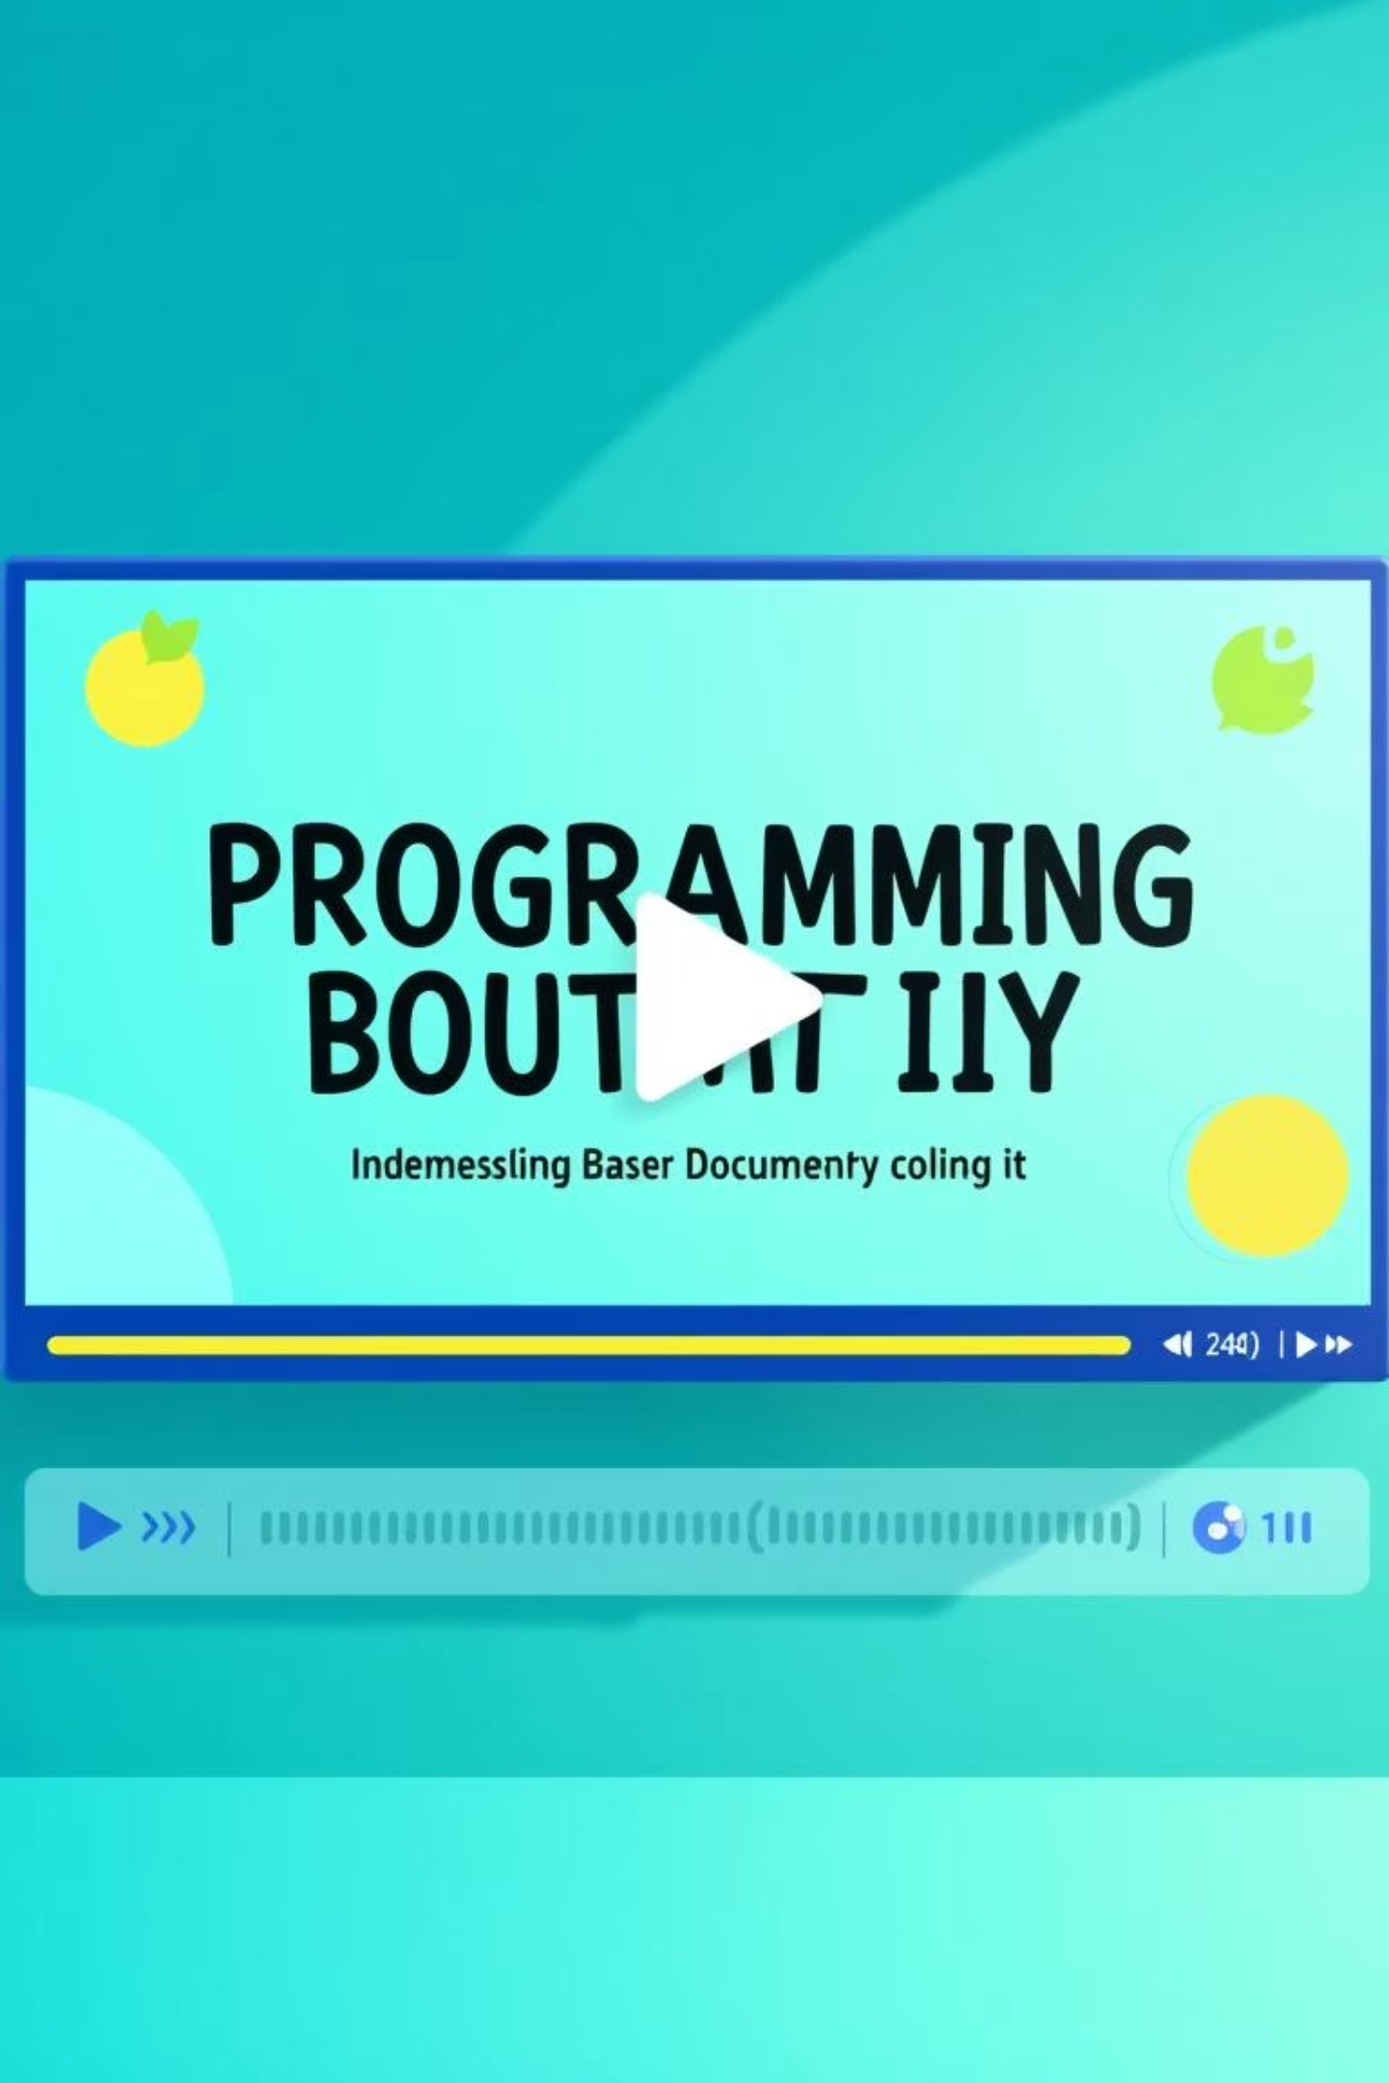
Discover Programming Through Video
Next, we'll watch a short animated documentary. It beautifully illustrates why learning programming is so beneficial. This video will make the concepts clear and engaging for everyone.
Watch the Documentary

Slide 4


Slide 5
Introducing to documentary
Title:
Why You Should Learn Programming
Runtime:
1 minute 45 seconds
Director:
HANO MEDIA
Release Date:
August 18, 2020
This documentary breaks down programming's value. It highlights its benefits and shows how easy and fun it is to begin your coding journey.

Slide 6
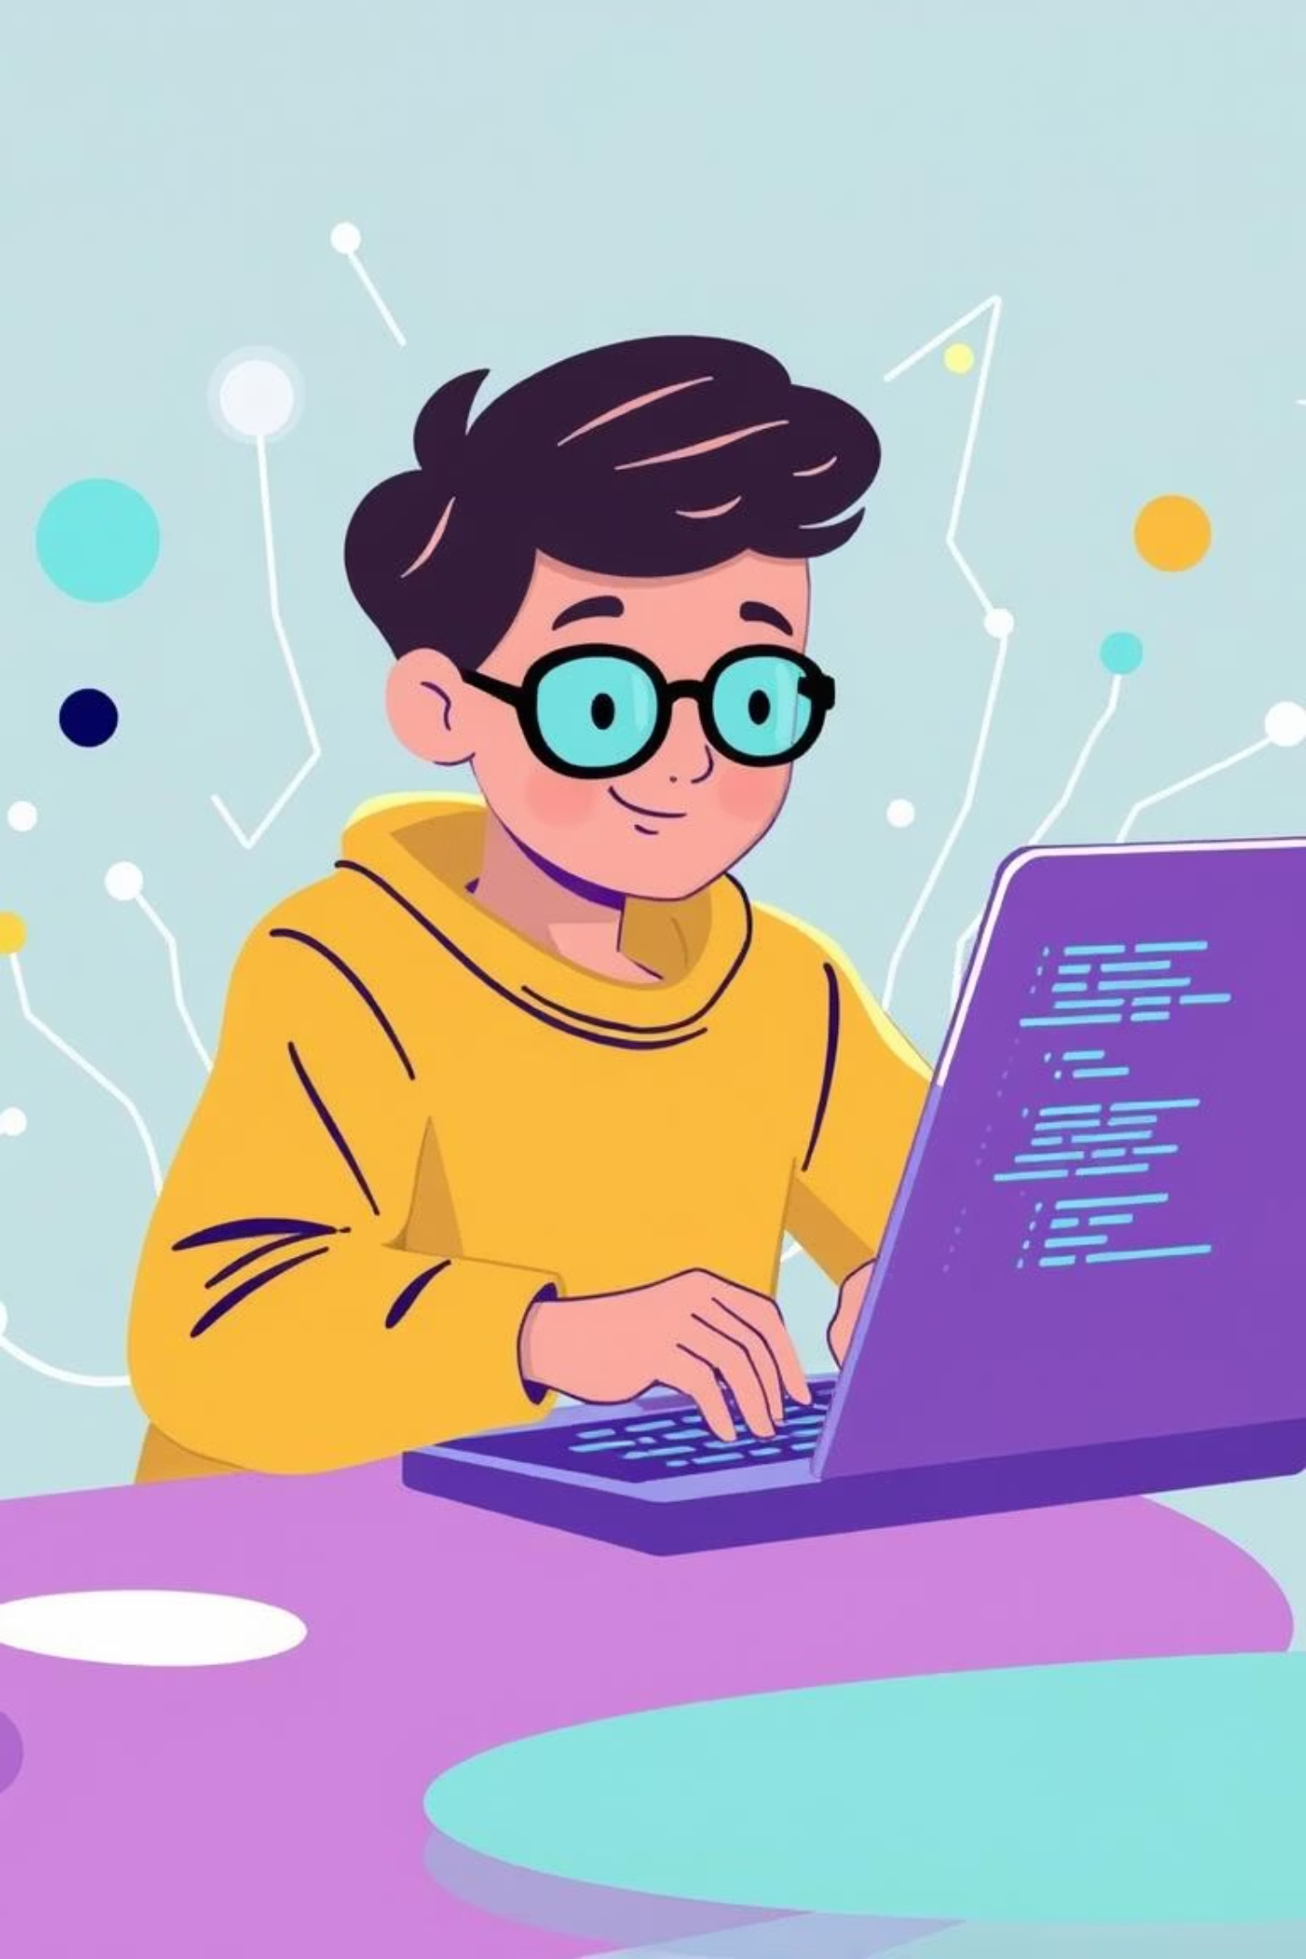
Main idea of documentary
The main idea of this documentary is to highlight how learning programming is a powerful and essential skill in today’s digital world. It explains that programming is not just for tech experts – it’s a creative, enjoyable, and valuable skill that anyone can learn to solve problems, build projects, and even earn money.

Slide 7
Key points of the Documentary
1
Programming is a valuable skill
It's powerful in today's world.
2
Why learn programming?
It benefits personal and professional life.
3
Programming opens minds
It expands thinking, problem-solving, and innovation.
4
Programming makes work easier
Automate tasks and solve real-life problems.
5
High-paying job opportunities
Programming offers lucrative careers in tech.
6
Learning programming is fun and easy
It's more enjoyable than you think.

Slide 8
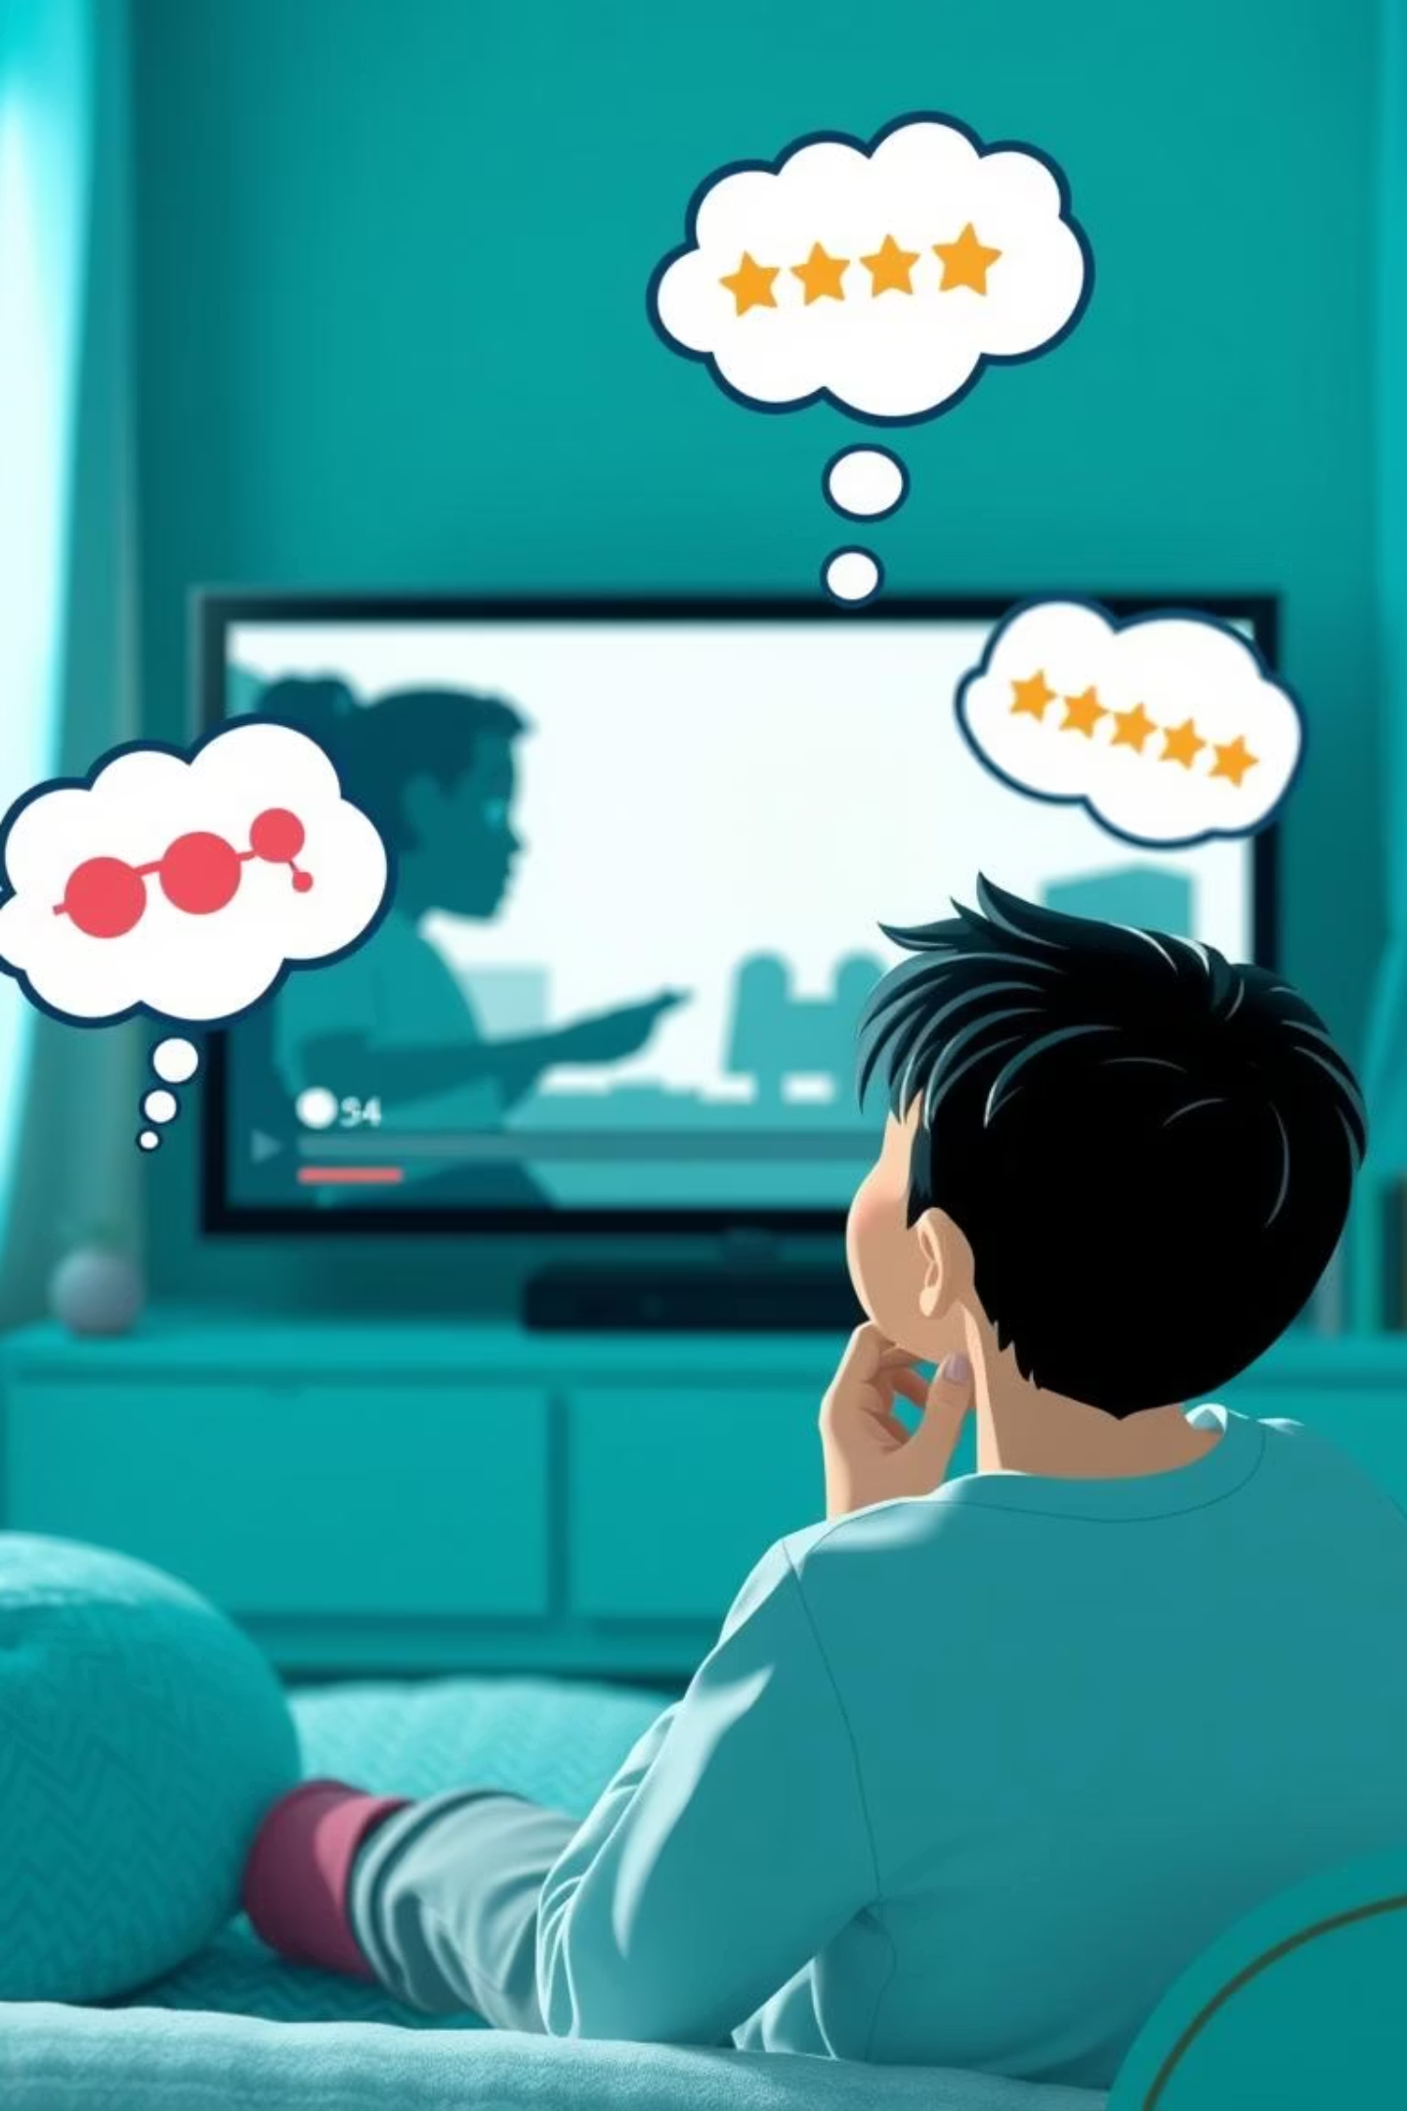



My opinions on the Documentary
Narration & Description
The narration was clear and smooth. Simple language made it perfect for beginners. It conveyed the message effectively.
Structure & Content
I appreciated the well-divided sections. Each part focused on a specific aspect of programming's importance.
Visuals & Animations
Attractive visuals kept the video engaging. They enhanced understanding without being boring.
Overall, this inspiring documentary explained programming's importance. I'd rate it a 9 out of 10!

Slide 9




Recommendations for Improvement
More Real-Life Examples
Success stories of programmers would be motivating. Show how people started from scratch.
Voice Tone & Energy
A more energetic tone would keep audiences engaged. Dynamic delivery enhances impact.
Visual Variety
Adding graphs or coding interface animations. This would make the video more appealing.
Small adjustments in storytelling and visuals could make this documentary even more powerful and inspiring for future programmers.

Slide 10

Conclusion
100%
100%
100%
Enjoyable Journey
New Skills Gained
Real-Life Impact
This project was fulfilling. I finally expressed my passion for programming.
I learned confident presentation and content analysis. It's truly helped me grow.
These skills are vital for my programming career. I can explain complex ideas clearly.
This experience has boosted my academic and personal confidence. I'm ready for future challenges!

Slide 11

Questions?
I hope you enjoyed this presentation and learned something new about programming. Thank you for your time and attention!

